Slide 1
FOOD CHAINS AND FOOD WEBS

Slide 2
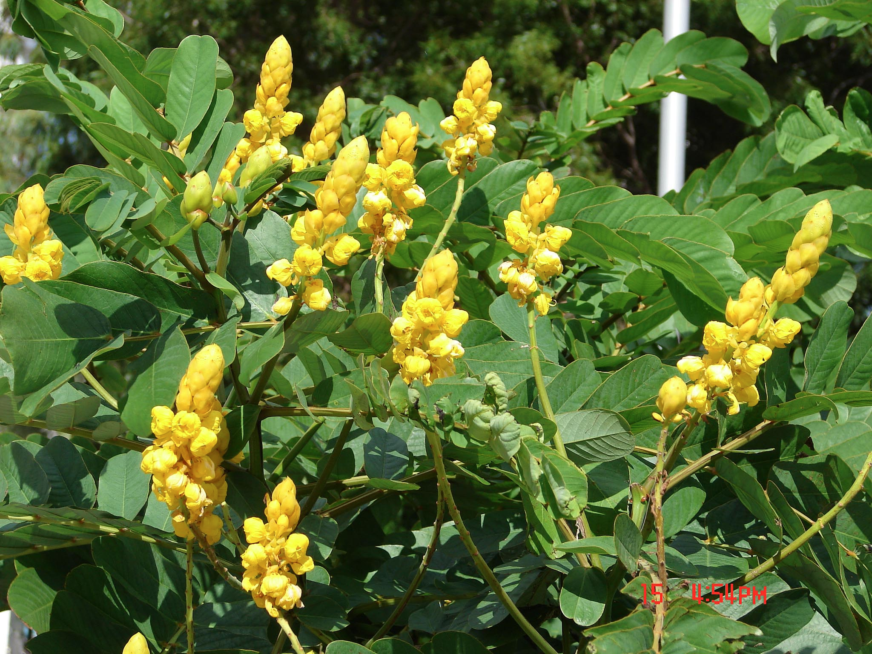
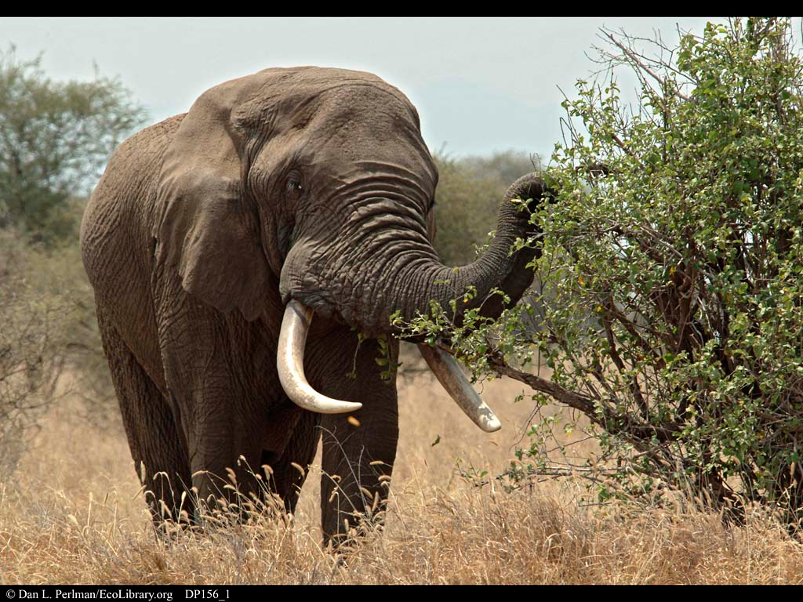
Words to Know
Producer – an organism that makes it’s own
food
*Plants are producers
Consumers – an organism that has to eat to get energy

Slide 3
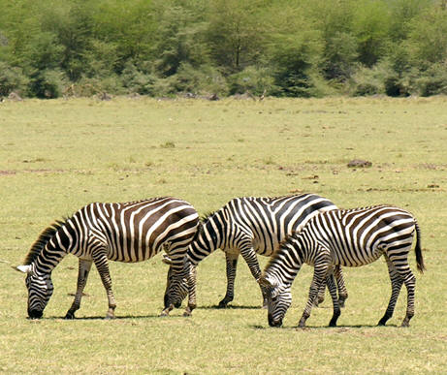
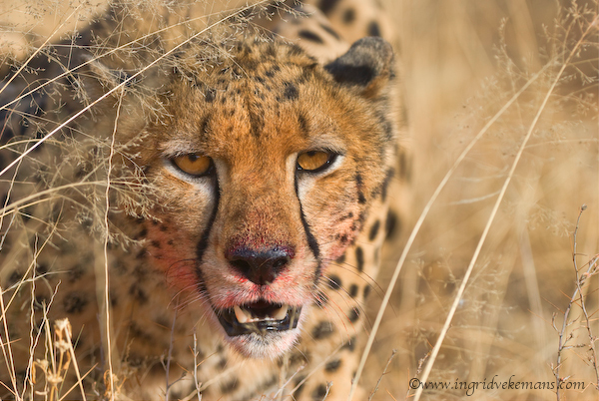
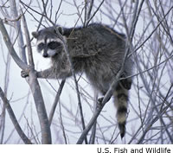
Types of Consumers
herbivore – an organism that only
eats plants
carnivore - an organism that only
eats meat
omnivore – an organism that eats
meat and plants

Slide 4
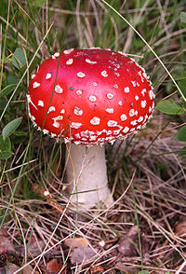
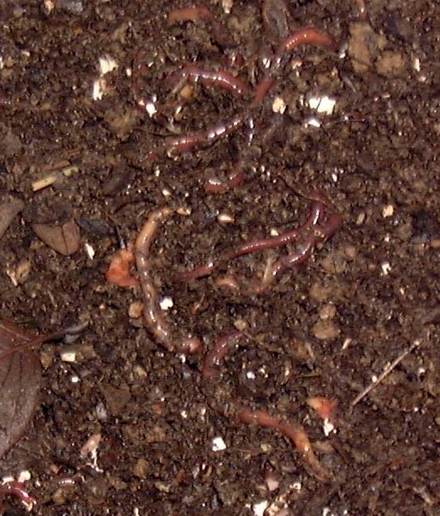
Decomposers
Break down dead plants and animals
Bacteria and fungi are two examples
Reduces dead organisms to simpler forms of matter
Returns them to the soil

Slide 5
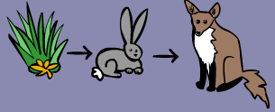
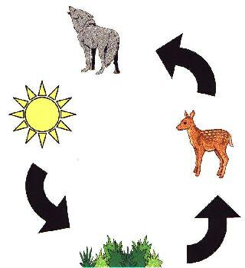
Food Chain
Shows how each living thing gets food
Always begins with the producer
Arrows show the flow of energy from one organism to another

Slide 6
Build a Food Chain
Click on the links below to build a food chain:
Chain Reaction Game
Food Chain Game

Slide 7
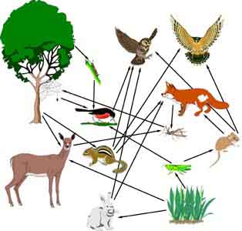
Food Web
A collection of food chains interconnected from the same ecosystem
Arrows show the flow of energy from one organism to another
Multiple consumers and producers

Slide 8
Build a Food Web
Click on the links below to build a food web:
Food Web
Fun with Food Webs

Slide 9
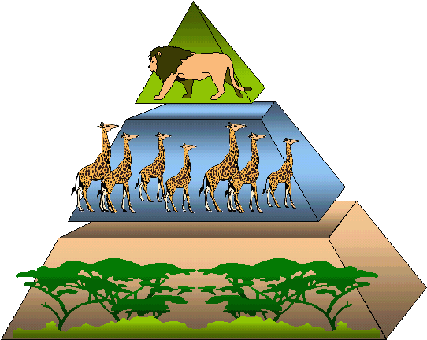
Energy Pyramid
Shows the amounts of energy available at each trophic level of an ecosystem
The higher in the pyramid, the less energy available

Slide 10
Find Out More About Energy Pyramids
Click on the button below to learn more:
Energy Pyramid

Slide 11
Quiz
A lion is a __________ because it eats only
meat.
carnivore
herbivore
omnivore

Slide 12
A _________ is a producer.
cheetah
plant
grasshopper

Slide 13
True or False.
A food web can have multiple consumers and
producers.
TRUE
FALSE

Slide 14
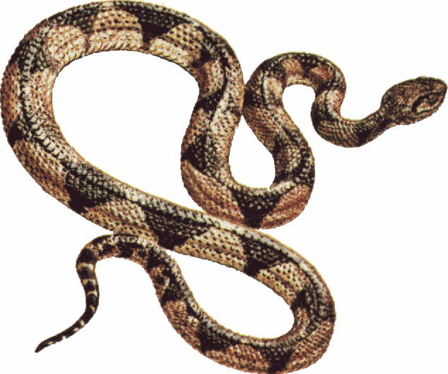
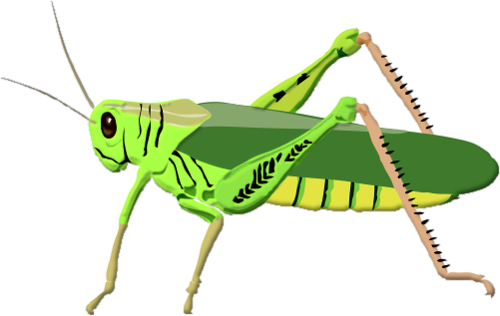
Which animal would fit in the blank of this
food chain?
?
hawk
zebra
mouse
butterfly

Slide 15
The plant gets its energy from the _______.
roots
stem
sun
flowers

Slide 16
CORRECT!!
Back to question

Slide 17
TRY AGAIN!
Back to question

